Slide 1
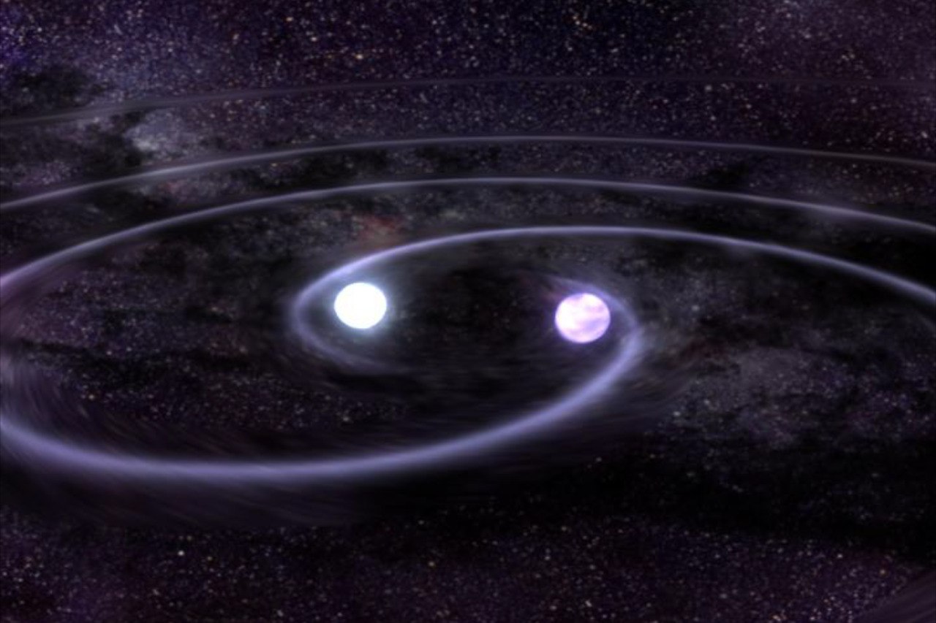
Detection of long period exoplanets by Gravitational Waves
Marcus Haberland

Slide 2
Points of interest
Exoplanet detection via GW
Predictions for LISA
Low-frequency GW searches in an ice giant mission
Results

Slide 3
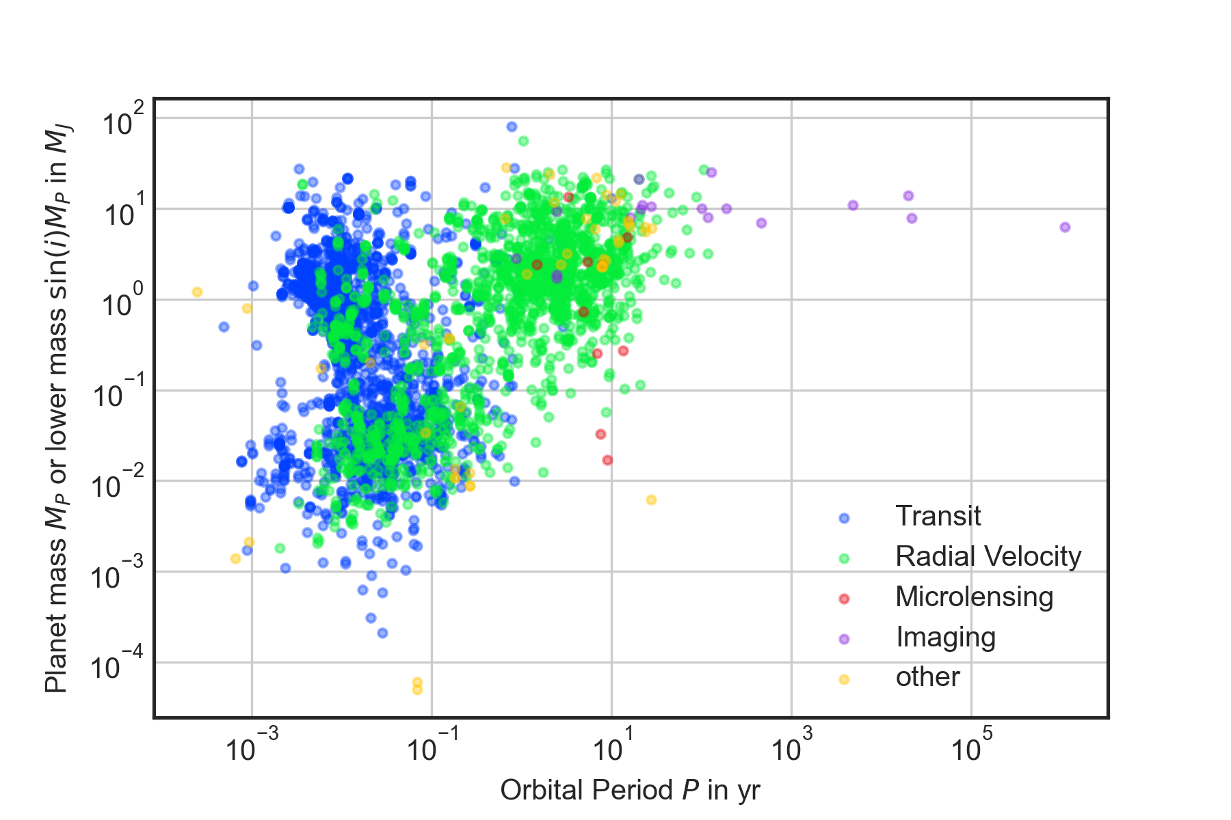
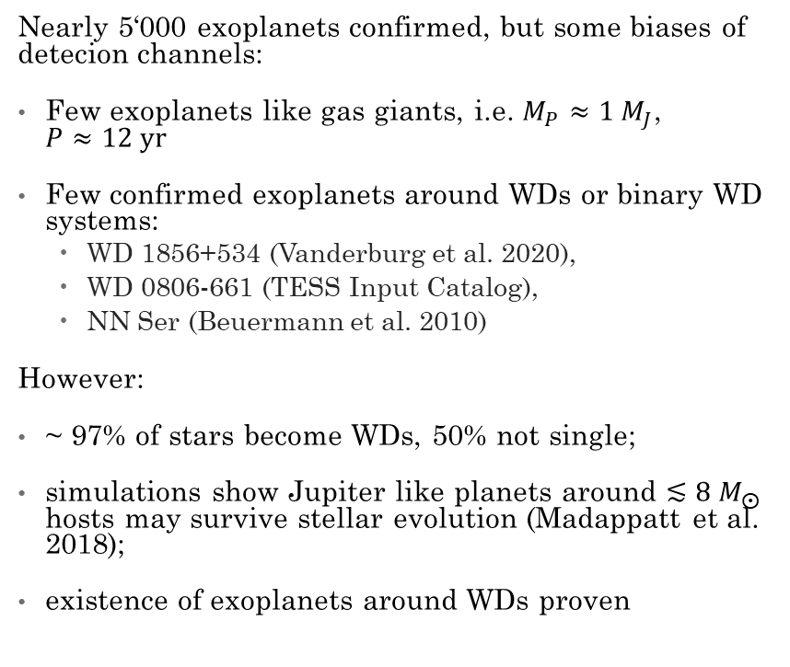
Exoplanets
Nearly 5‘000 exoplanets confirmed, but some biases of detecion channels:
Few exoplanets like gas giants, i.e. $M_{P}≈1 M_{J}$,
$P≈12 yr$
Few confirmed exoplanets around WDs or binary WD systems:
  WD 1856+534 (Vanderburg et al. 2020),
  WD 0806-661 (TESS Input Catalog),
  NN Ser (Beuermann et al. 2010)
However:
~ 97% of stars become WDs, 50% not single;
simulations show Jupiter like planets around $≲8{ M}_{⨀}$ hosts may survive stellar evolution (Madappatt et al. 2018);
existence of exoplanets around WDs proven
Confirmed exoplanets with specified exoplanet mass and orpital period. Data taken from the NASA Exoplanet Archive.

Slide 4
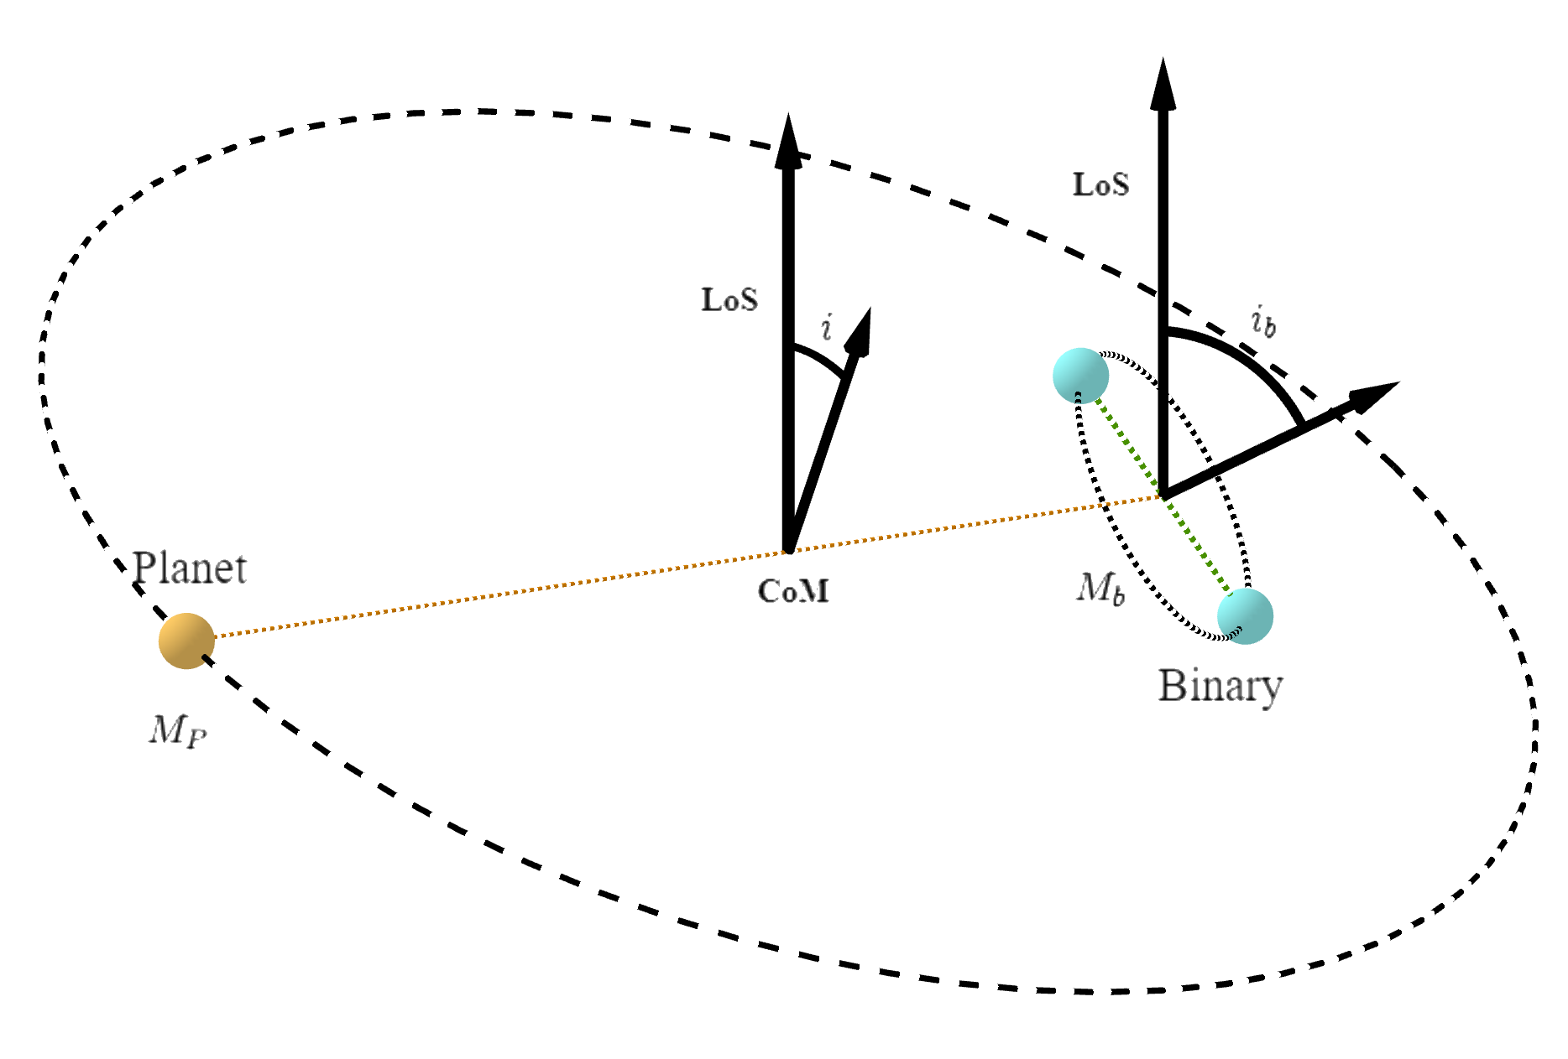
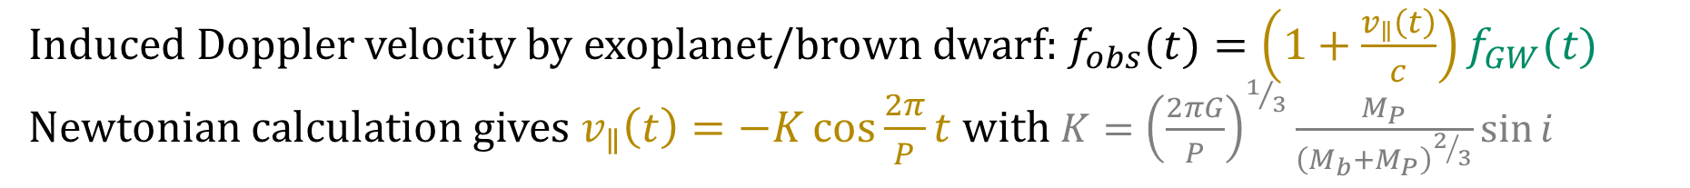
Exoplanet detection via GW
Induced Doppler velocity by exoplanet/brown dwarf: $f_{obs}(t)=\left(1+\frac{v_{∥}\left(t\right)}{c}\right)f_{GW}(t)$
Newtonian calculation gives $v_{∥}\left(t\right)=−K\cos{\frac{2π}{P}t}$ with $K={\left(\frac{2πG}{P}\right)}^{1/3}\frac{M_{P}}{{\left(M_{b}+M_{P}\right)}^{2/3}}\sin{i}$

Slide 5
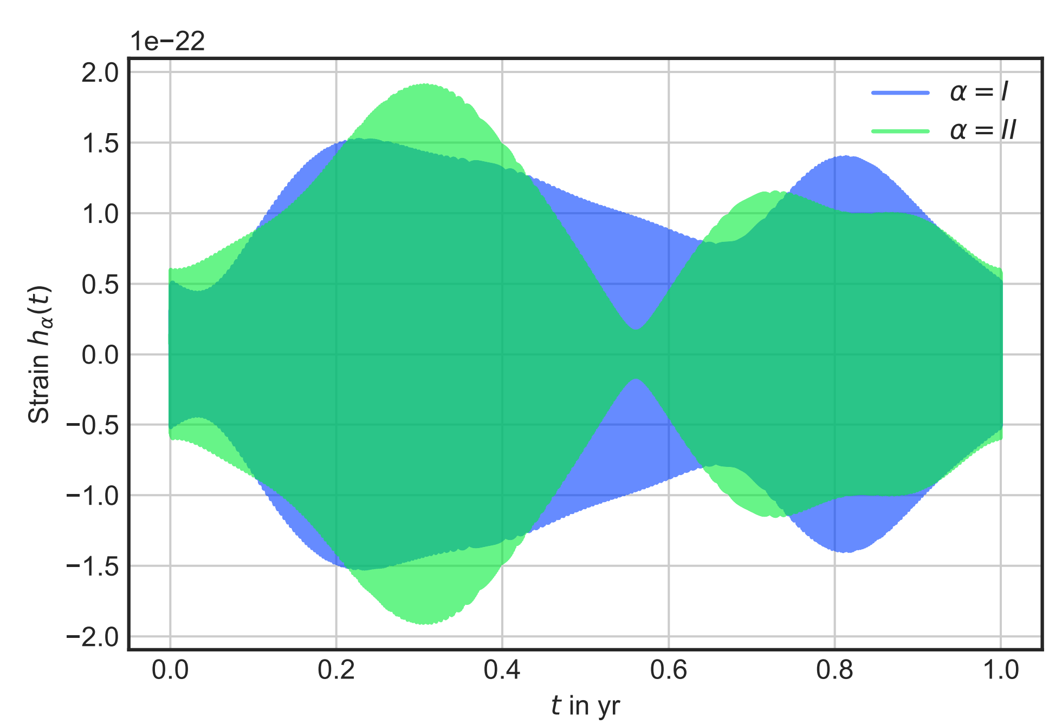
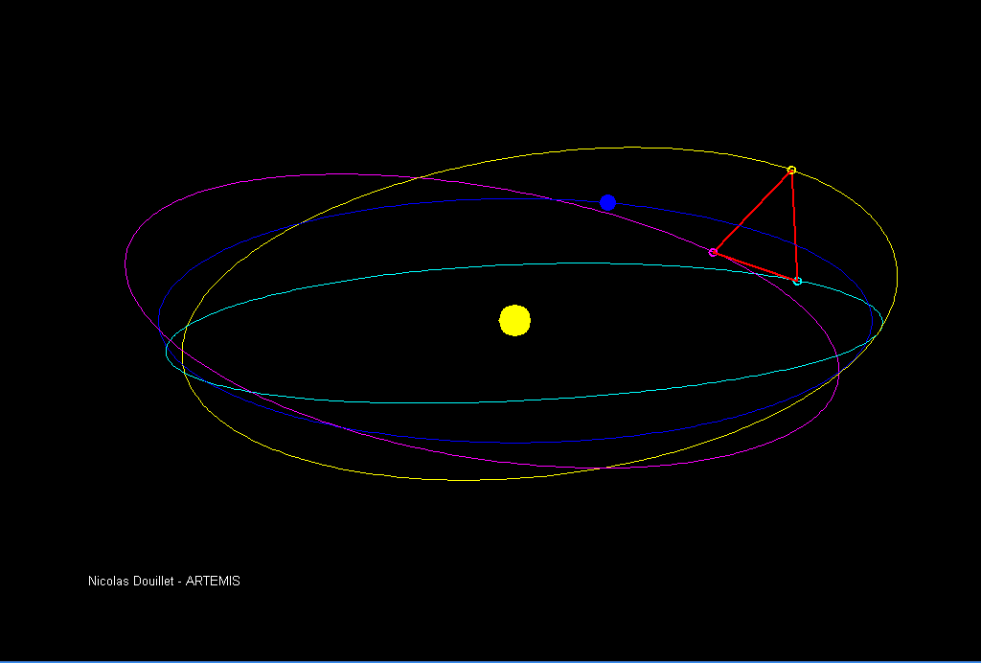
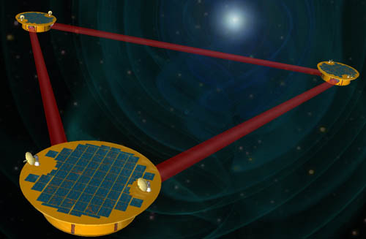
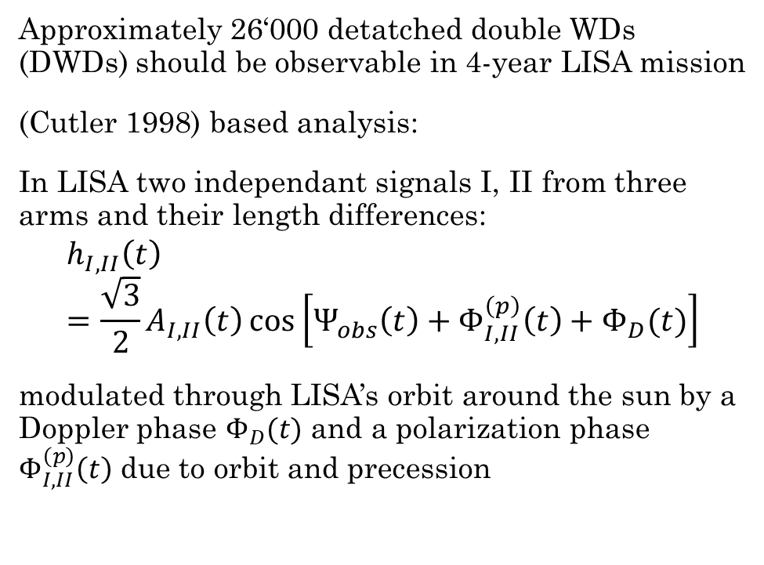

LISA
Approximately 26‘000 detatched double WDs (DWDs) should be observable in 4-year LISA mission
(Cutler 1998) based analysis:
In LISA two independant signals I, II from three arms and their length differences:
$$h_{I,II}\left(t\right)=\frac{\sqrt{3}}{2}A_{I,II}\left(t\right)\cos\left[Ψ_{obs}\left(t\right)+Φ_{I,II}^{\left(p\right)}\left(t\right)+Φ_{D}(t)\right]$$
modulated through LISA’s orbit around the sun by a Doppler phase $Φ_{D}(t)$ and a polarization phase $Φ_{I,II}^{\left(p\right)}\left(t\right)$ due to orbit and precession
$$h_{II}\left(t\right)$$
$$h_{I}\left(t\right)$$

Slide 6
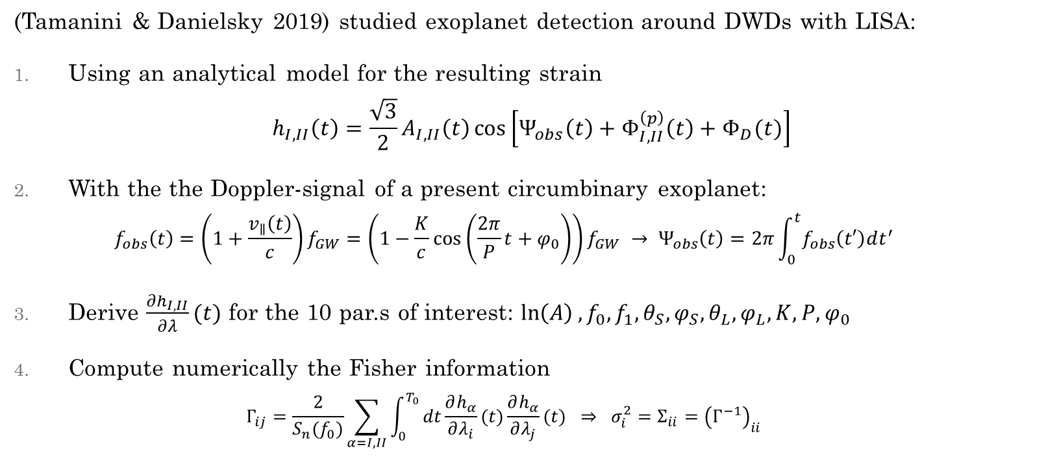
Predicting the uncertainties
(Tamanini & Danielsky 2019) studied exoplanet detection around DWDs with LISA:
Using an analytical model for the resulting strain
$h_{I,II}\left(t\right)=\frac{\sqrt{3}}{2}A_{I,II}\left(t\right)\cos\left[Ψ_{obs}\left(t\right)+Φ_{I,II}^{\left(p\right)}\left(t\right)+Φ_{D}(t)\right]$
With the the Doppler-signal of a present circumbinary exoplanet:
$f_{obs}\left(t\right)=\left(1+\frac{v_{∥}\left(t\right)}{c}\right)f_{GW}=\left(1−\frac{K}{c}\cos\left(\frac{2π}{P}t+φ_{0}\right)\right)f_{GW} → Ψ_{obs}\left(t\right)=2π\int_{0}^{t}{f_{obs}\left(t′\right)dt^{′}}$
Derive $\frac{∂h_{I,II}}{∂λ}(t)$ for the 10 par.s of interest: $\ln\left(A\right), f_{0},f_{1},θ_{S},φ_{S},θ_{L},φ_{L},K,P,φ_{0}$
Compute numerically the Fisher information
$Γ_{ij}=\frac{2}{S_{n}(f_{0})}\sum_{α=I,II}{\int_{0}^{T_{0}}{dt\frac{∂h_{α}}{∂λ_{i}}(t)\frac{∂h_{α}}{∂λ_{j}}(t)} } ⇒ σ_{i}^{2}=Σ_{ii}={\left(Γ^{−1}\right)}_{ii}$

Slide 7
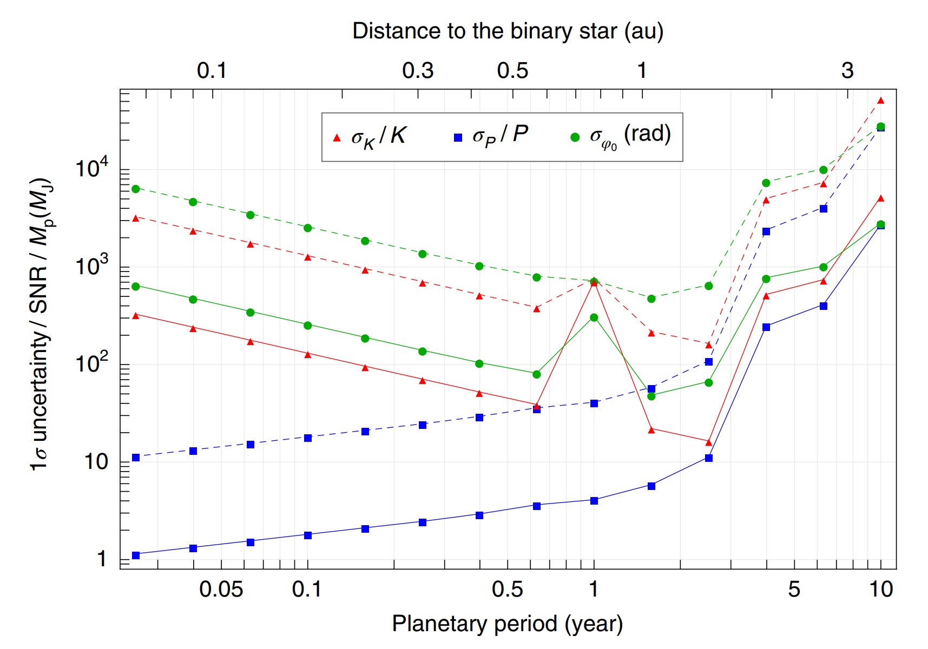
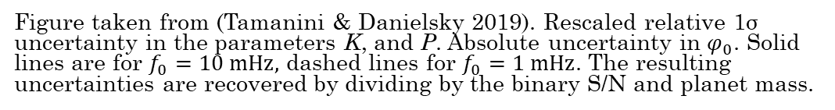
Predicting the uncertainties
Bottlenecks:
High signal-to-noise ratios S/N needed for detection
One-year degeneracy due to LISA‘s orbit and resulting Doppler phase
Degeneracy after LISA‘s nominal life time due to incapability of resolving long period exoplanet‘s Doppler signal
Figure taken from (Tamanini & Danielsky 2019). Rescaled relative 1σ uncertainty in the parameters K, and P. Absolute uncertainty in $φ_{0}$. Solid lines are for $f_{0}=10 mHz,$ dashed lines for $f_{0}=1 mHz$. The resulting uncertainties are recovered by dividing by the binary S/N and planet mass.

Slide 8
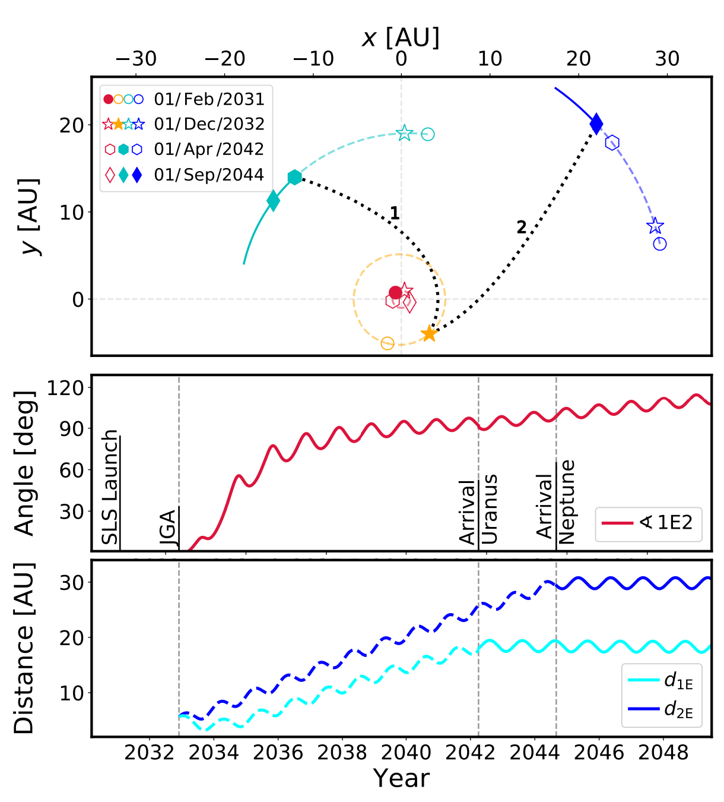
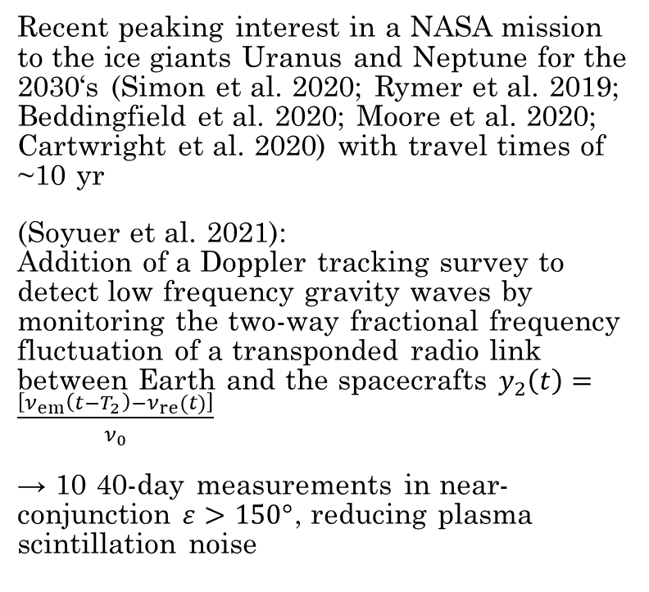
Ice Giant missions
Recent peaking interest in a NASA mission to the ice giants Uranus and Neptune for the 2030‘s (Simon et al. 2020; Rymer et al. 2019; Beddingfield et al. 2020; Moore et al. 2020; Cartwright et al. 2020) with travel times of ~10 yr
(Soyuer et al. 2021):
Addition of a Doppler tracking survey to detect low frequency gravity waves by monitoring the two-way fractional frequency fluctuation of a transponded radio link between Earth and the spacecrafts $y_{2}\left(t\right)=\frac{\left[ν_{em}\left(t−T_{2}\right)−ν_{re}(t)\right]}{ν_{0}}$
→ 10 40-day measurements in near-conjunction $ε>150°$, reducing plasma scintillation noise
Figure taken from (Soyuer et al. 2021). Top: Orbital positions of Earth, Jupiter, Uranus and Neptune around the sun for a JPL mission concept with Jupiter Gravity Assist. Centre: Angle between Uranus spacecraft (1), Earth (E) and Neptune spacecraft (2). Bottom: Distance to the spacecrafts

Slide 9
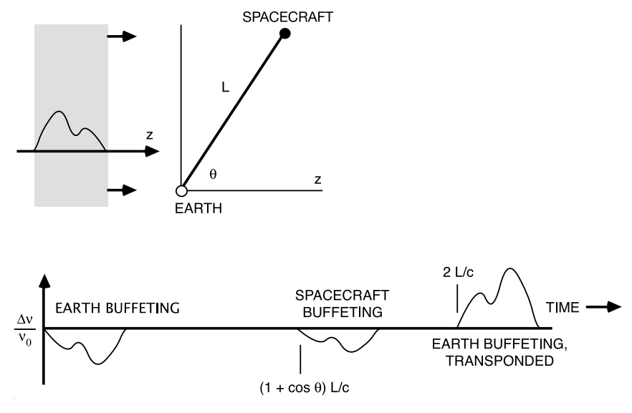
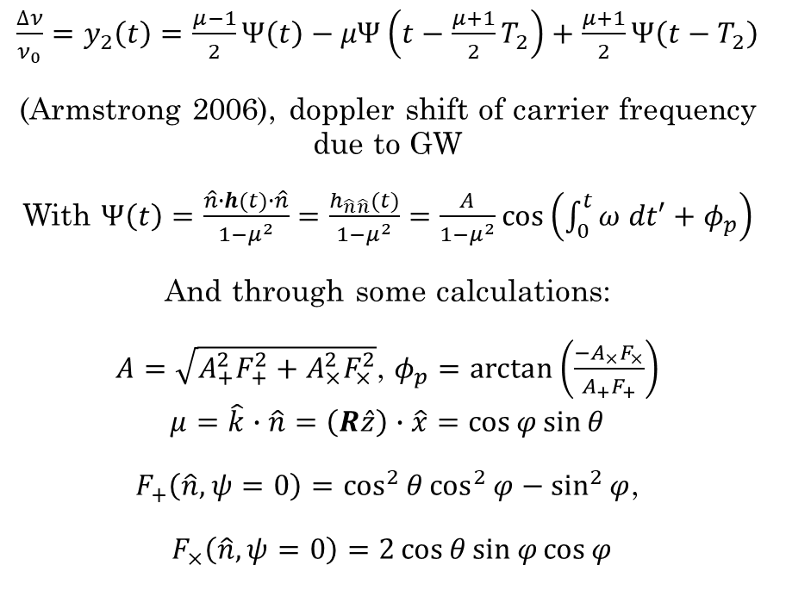
Doppler tracking surveys
$\frac{∆ν}{ν_{0}}=y_{2}\left(t\right)=\frac{μ−1}{2}Ψ\left(t\right)−μΨ\left(t−\frac{μ+1}{2}T_{2}\right)+\frac{μ+1}{2}Ψ\left(t−T_{2}\right)$
(Armstrong 2006), doppler shift of carrier frequency due to GW
With $Ψ\left(t\right)=\frac{\hat{n}∙h(t)∙\hat{n}}{1−μ^{2}}=\frac{h_{\hat{n}\hat{n}}(t)}{1−μ^{2}}=\frac{A}{1−μ^{2}}\cos\left(\int_{0}^{t}{ω dt′}+φ_{p}\right)$
And through some calculations:
$A=\sqrt{A_{+}^{2}F_{+}^{2}+A_{×}^{2}F_{×}^{2}}$, $φ_{p}=arctan\left(\frac{−A_{×}F_{×}}{A_{+}F_{+}}\right)$
$$μ=\hat{k}∙\hat{n}=\left(R\hat{z}\right)∙\hat{x}=\cos{φ}\sin{θ}$$
$F_{+}\left(\hat{n},ψ=0\right)=\cos^{2}{θ}\cos^{2}{φ}−\sin^{2}{φ}$,
$F_{×}\left(\hat{n},ψ=0\right)=2\cos{θ}\sin{φ}\cos{φ}$
Figure taken from (Armstrong 2006). Schematic response of two-way Doppler tracking to a GW. Note the three pulse character, which may lead to cancellation for particular systems.

Slide 10
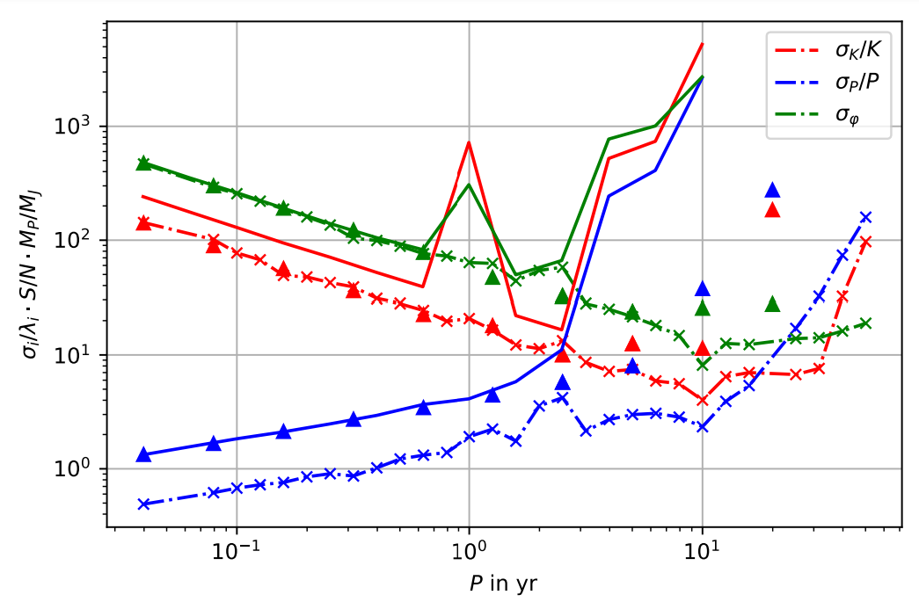
Analysis of the signal
A single ice giant mission will be insensitive to the polarization state i.e. orbital orientation and position of a DWD
Setting the DWD characteristics (WD masses, seperation, position, orbital orientation) as fixed, we can study the resolution of exoplanets around DWDs in LISA (solid lines from (Tamanini & Danielsky 2019) as a reference, triangles for reduced parameter space search) and an ice giant mission (crosses)
→ S/N > 10 needed even under ideal circumstances

Slide 11
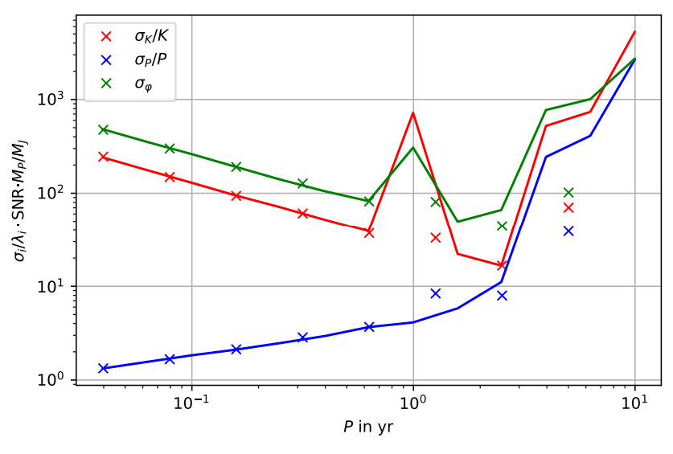
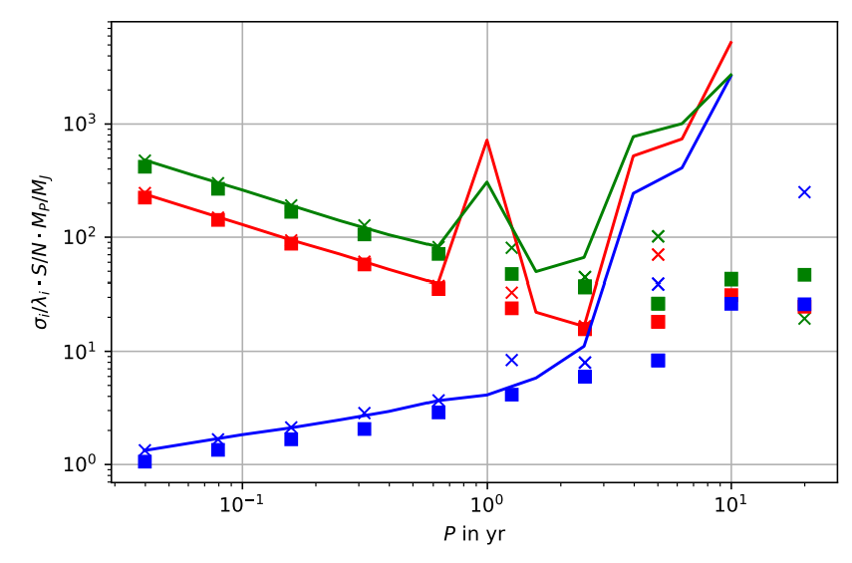
Combined measurements
Result for a Fisher information analysis as performed by us (crosses) and (Tamanini & Danielsky 2019, solid lines). Our analysis was limited by computational power in the numerical integration.
Addition of an Ice Giant Doppler tracking survey with 10% the S/N for a given DWD system in a joint search (squares). Result for LISA on its own included as a reference.

Slide 12
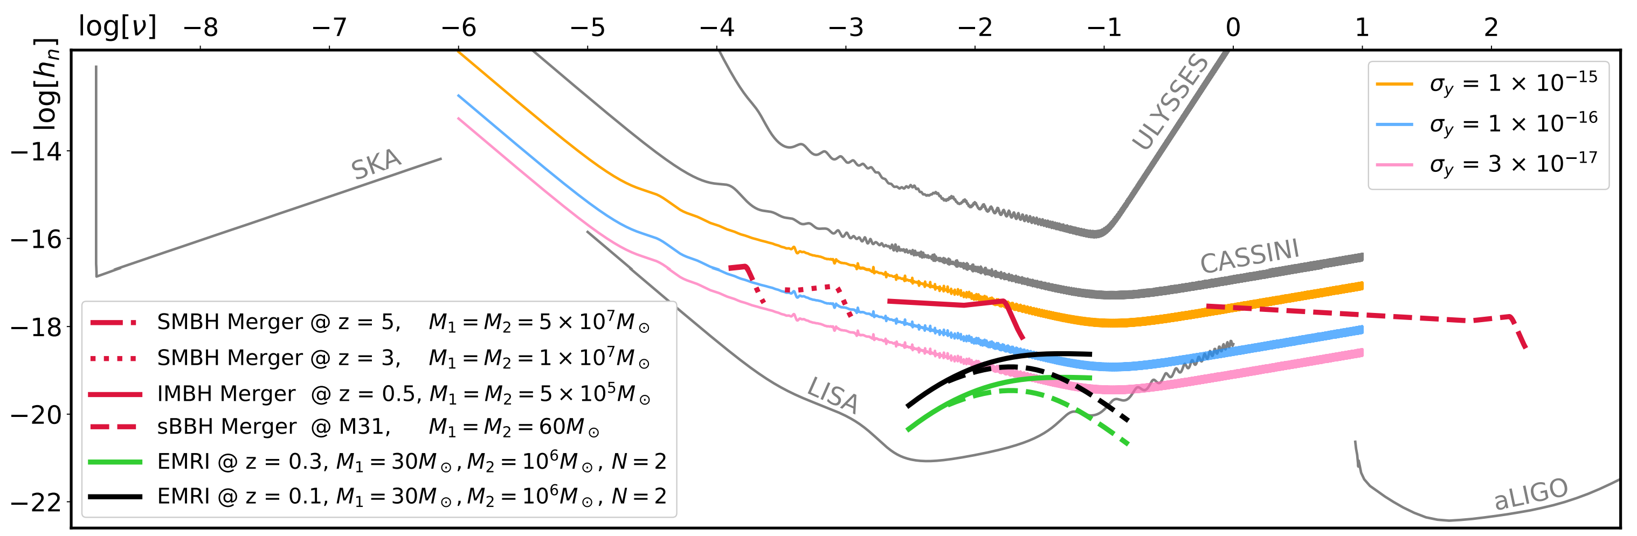
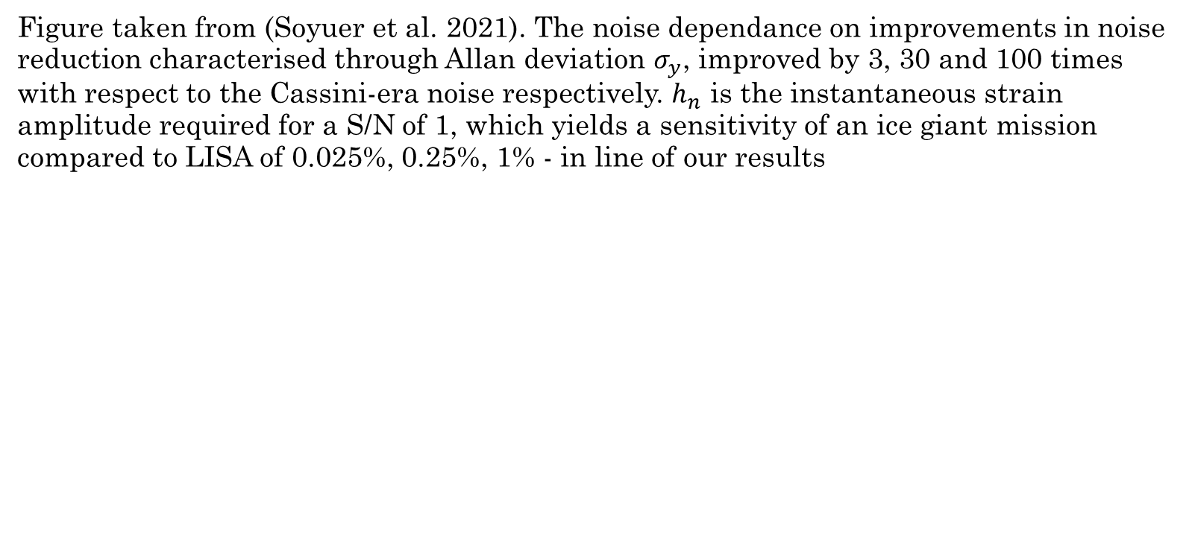
Noise in an ice giant mission
Figure taken from (Soyuer et al. 2021). The noise dependance on improvements in noise reduction characterised through Allan deviation $σ_{y}$, improved by 3, 30 and 100 times with respect to the Cassini-era noise respectively. $h_{n}$ is the instantaneous strain amplitude required for a S/N of 1, which yields a sensitivity of an ice giant mission compared to LISA of 0.025%, 0.25%, 1% - in line of our results

Slide 13
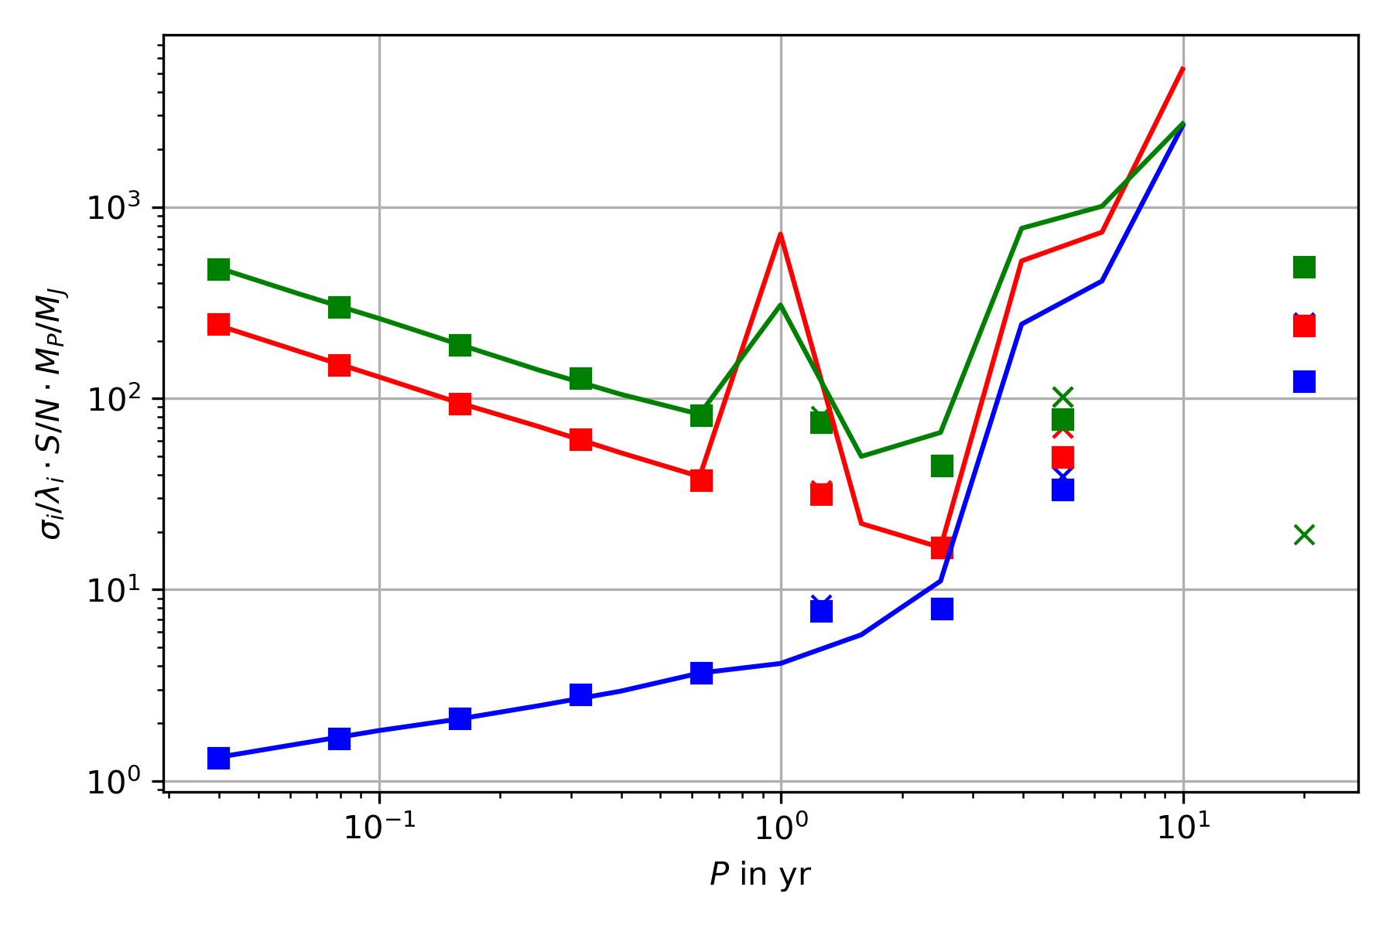
Conclusion
Ice giant could be a valuable addition to LISA in order to constrain long period exoplanets around DWD systems in the Milky Way
Necessary for any detection is however an improvement in noise reduction i.e. Allan deviation of at least 100 fold compared to Cassini-era noise
Future interest: How many more exoplanets
could be detectable with an added ice giant
mission? Compare 3 to 83 potential exoplanets
with LISA on its own (Danielsky et al. 2019)

Slide 14
Thank you for your attention!
Do you have any questions or remarks?

Slide 15
Main References
Tamanini, N., Danielski, C. (2019). The gravitational-wave detection of exoplanets orbiting white dwarf binaries using LISA. Nat Astron 3, 858–866. https://doi.org/10.1038/s41550-019-0807-y
Danielski, C., Korol, V., Tamanini, N., & Rossi, E.M. (2019). Circumbinary exoplanets and brown dwarfs with the Laser Interferometer Space Antenna. Astronomy and Astrophysics, 632.
Cutler, C. (1998). Angular resolution of the LISA gravitational wave detector. Physical Review D, 57, 7089-7102.
Soyuer, D., Zwick, L., D’Orazio, D., Saha, P. (2021). Searching for gravitational waves via Doppler tracking by future missions to Uranus and Neptune. MNRAS: Letters, 503, 1, L73-79. https://doi.org/10.1093/mnrasl/slab025
Armstrong, J. W. 2006, Living Reviews in Relativity, 9, 1
Maggiore, M. (2008). Gravitational Waves Volume 1: Theory and Experiments. Oxford University Press

Slide 16
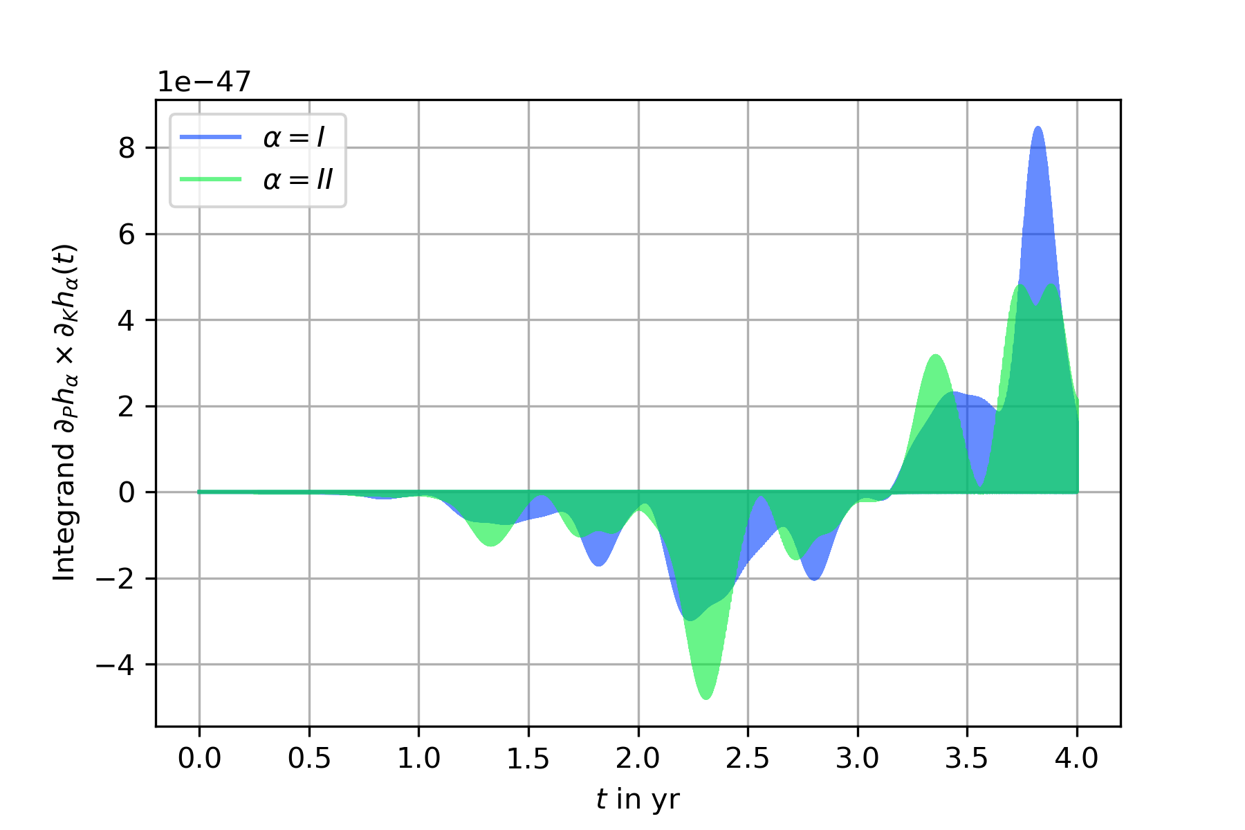
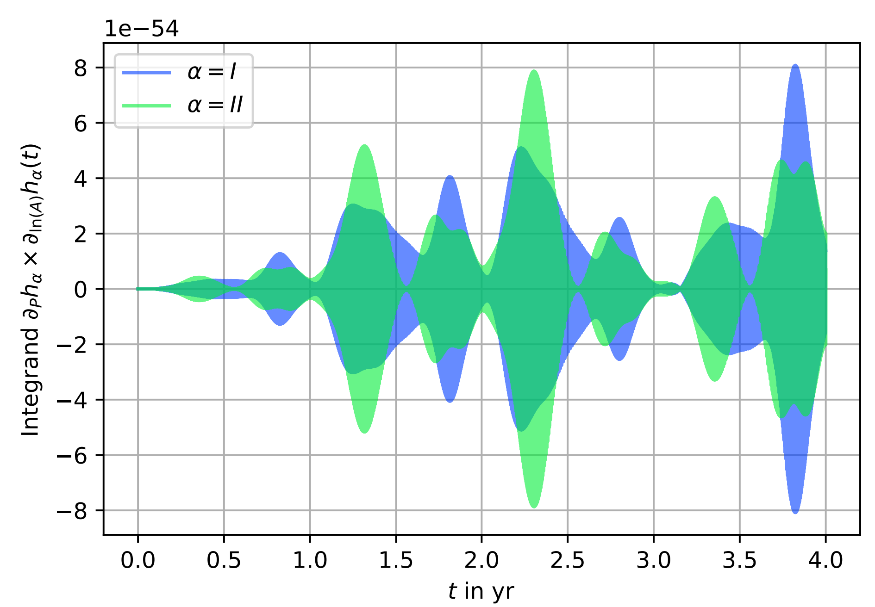
Appendix
Examples of the integrands for the Fisher information computation for an 8.5 yr period exoplanet

